Slide 1
CS3402 Software Design
Group Project
Book Trading System
Group 23

Slide 2
Members
53423679 YAMANOUCHI Moana - Project Manager
53152722 JEONG Do Hyung - Assistant Project Manager
53571049 LAI Yan Lok - Software Designer
53812347 BARNHART Nicholas - Software Designer
53568402 WONG Nok Ching - Software Designer
53083503 YEUNG Zhi-I - Software Designer

Slide 3
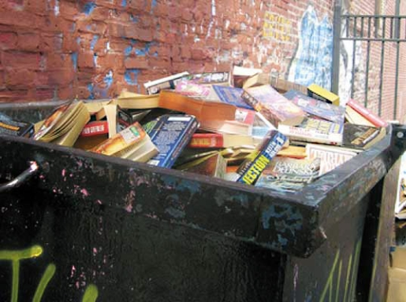

Why do we need this project?
What do we do with...
UNWANTED & EXPENSIVE books???

Slide 4
What is a Book Trading System?
Register online
Recognition & Verification
Get bookcoin accordingly
Use bookcoin to buy other books you are interested in
(optional) you can also purchase bookcoin

Slide 5
Objectives
Developing a system in which users may sell and buy books within a moderated system and professional library.
Creating class, sequence, and use-case diagrams to portray the functionality of our system.
To explore the feasibility of a book recycling system, as well as approaching the risks and constraints in a professional manner
To give reason to the utilization of software design principles, patterns and strategies.

Slide 6
Use-Case Diagram

Slide 7
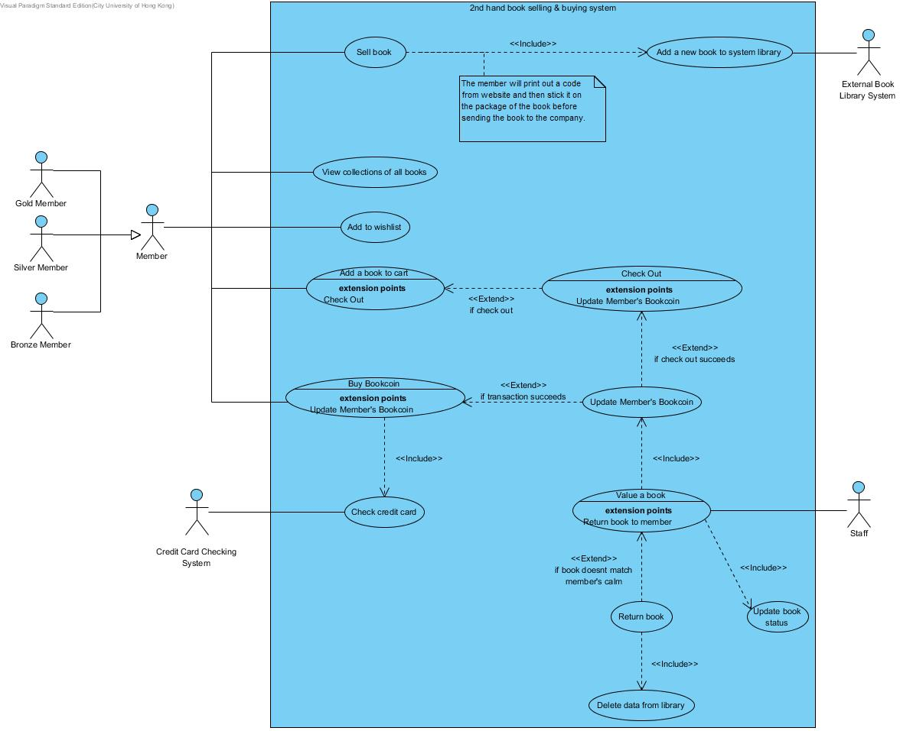

Slide 8
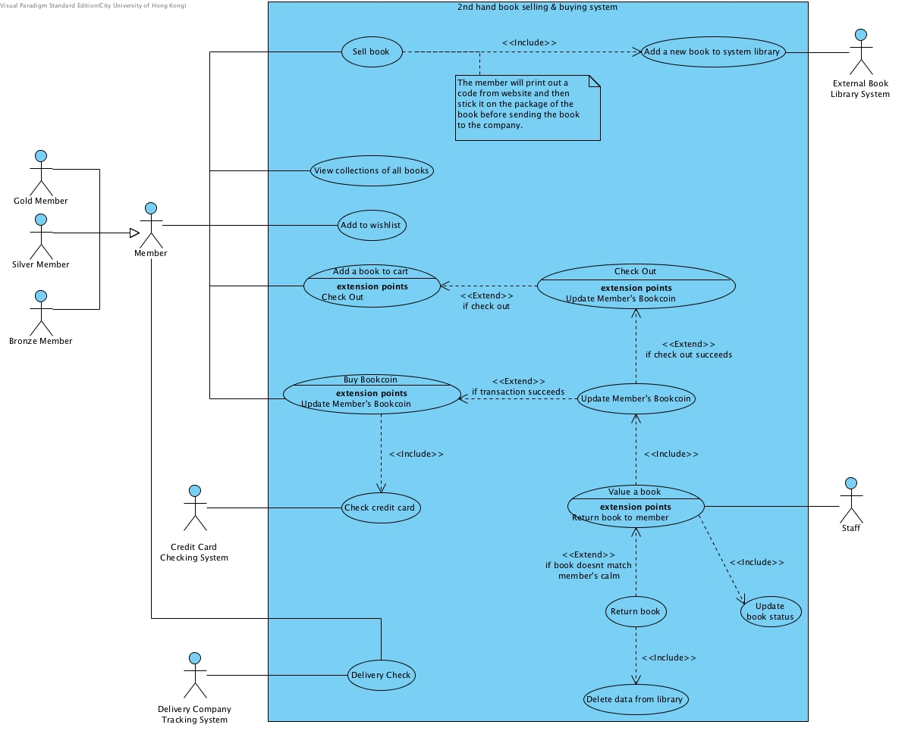

Slide 9
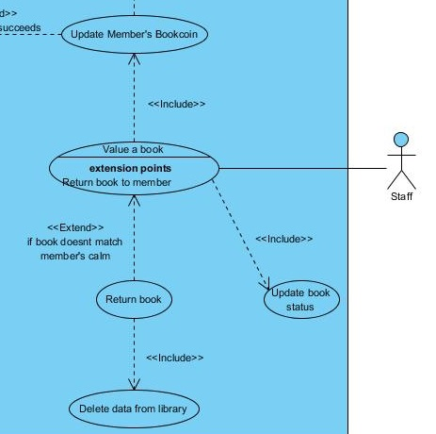

Slide 10
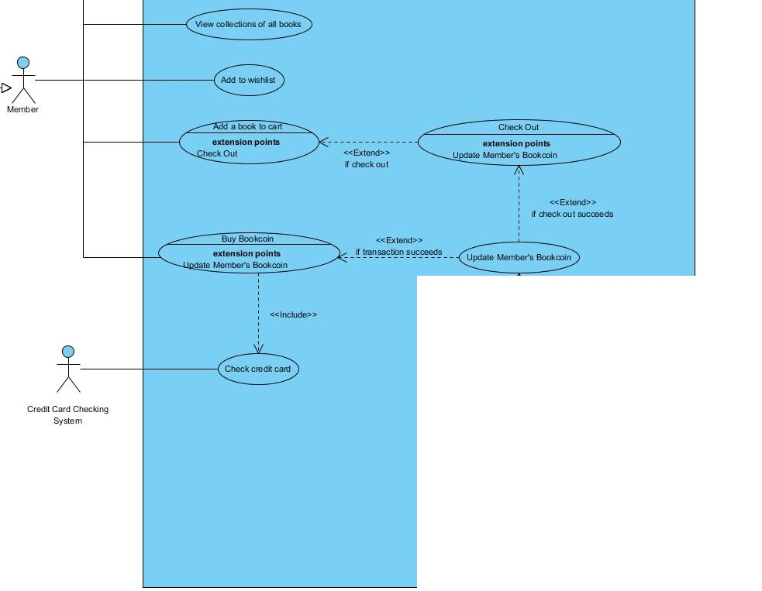

Slide 12
Class Diagram &
Sequence Diagrams

Slide 13
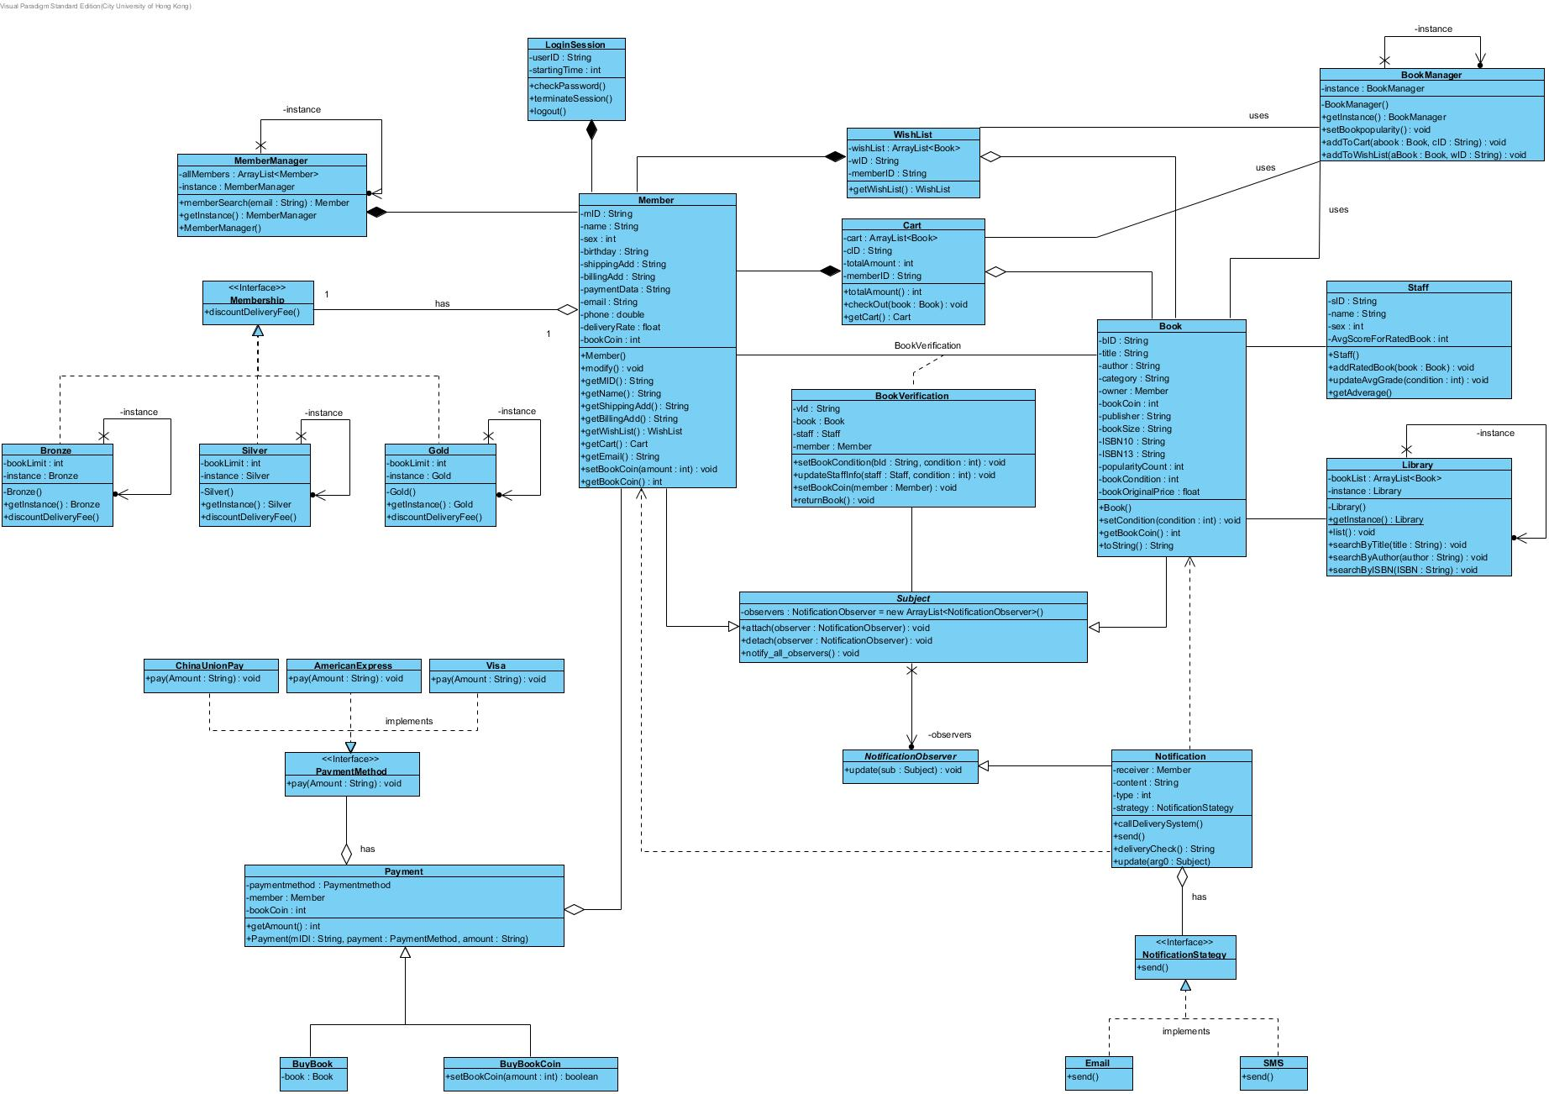
Class Diagram Overview

Slide 14
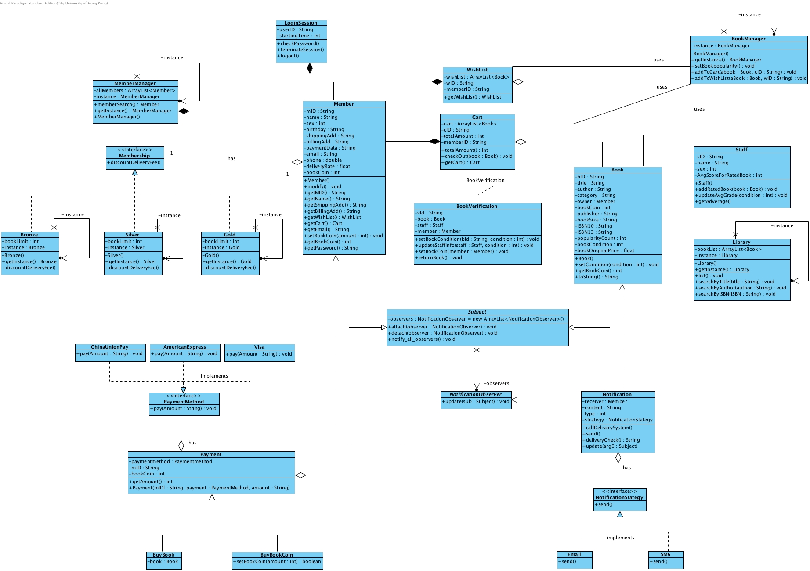

Class Diagram Overview

Slide 15
Class Diagram Overview

Slide 16
Class Diagram Overview

Slide 17
Class Diagram Overview

Slide 18
Class Diagram Overview

Slide 19
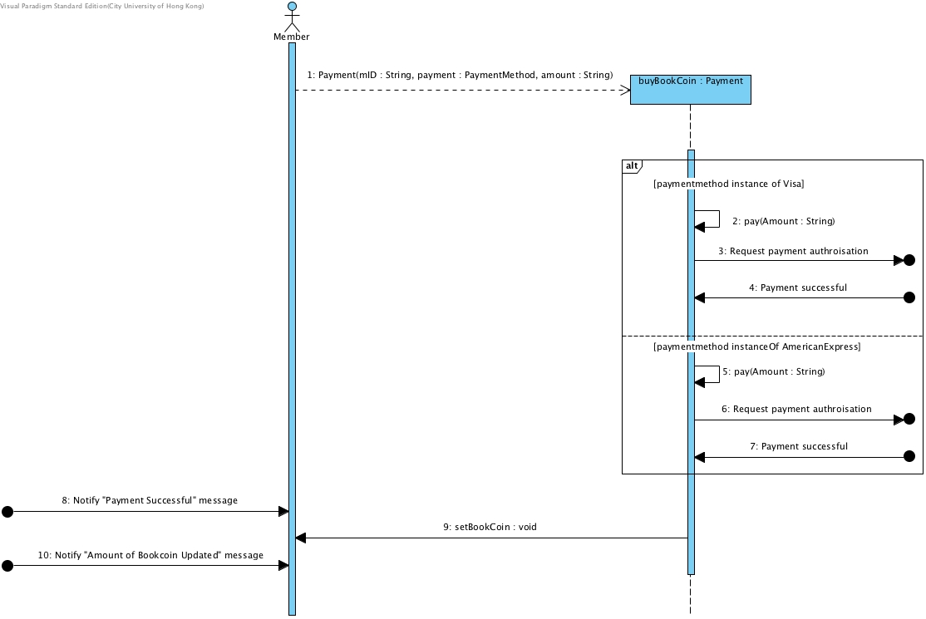
Buy Bookcoin

Slide 20
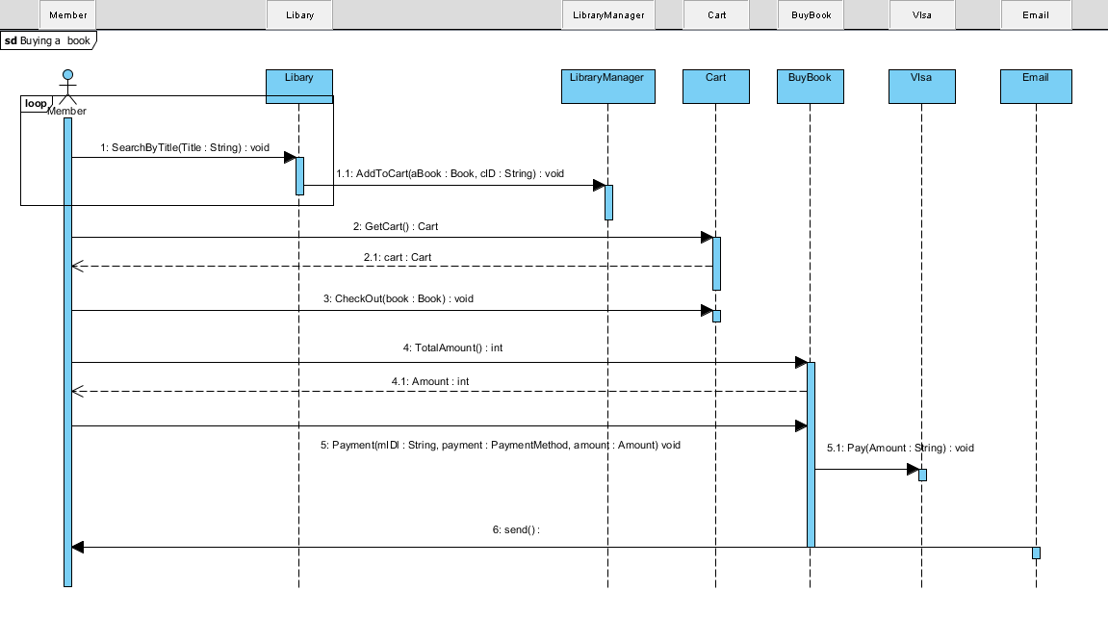
Add book to Cart & Purchasing

Slide 21
Design Patterns

Slide 22
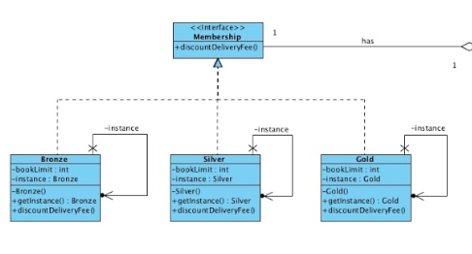
State Pattern
Membership

Slide 23
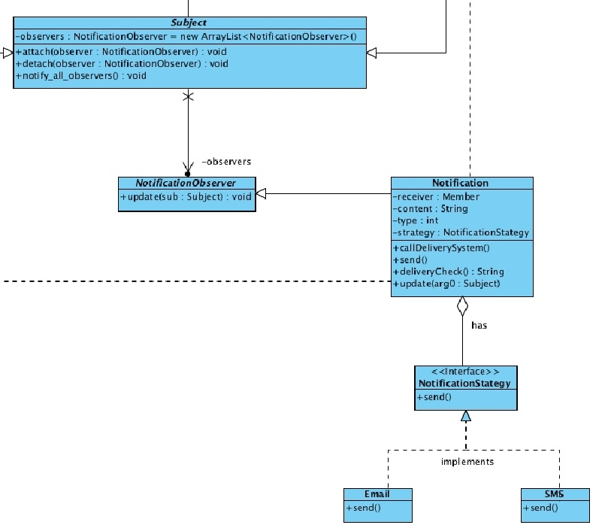
Observer Pattern
Notification as the
Observer

Slide 24
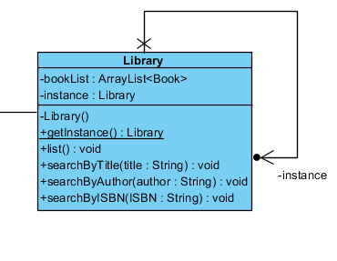
Singleton Pattern
Library Class
MemberManager Class

Slide 25

Strategy Pattern
- Payment method
- Notification

Slide 26
Design Principles

Slide 27
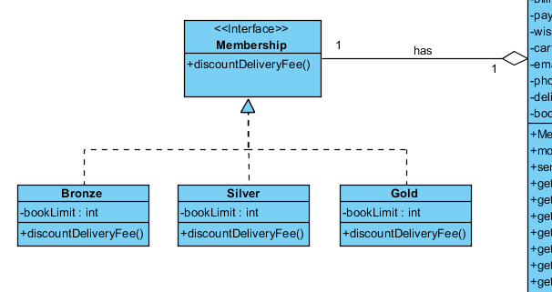
Open-Closed Principle (OCP)
Open for extension
Closed for modification

Slide 28
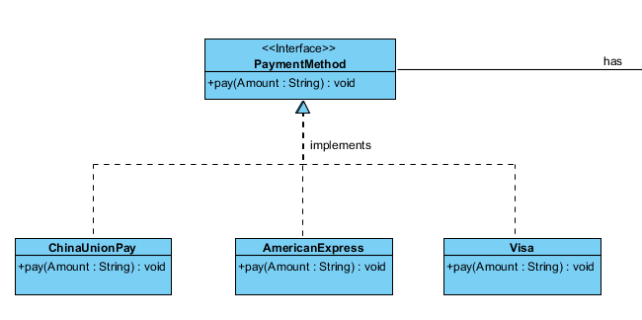
Liskov Substitution Principle (LSP)
Derived subclasses must be completely substitutable for their parent class

Slide 29
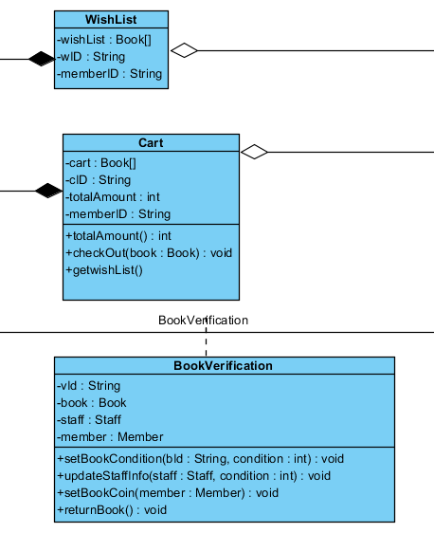
Single Responsibility Principle (SRP)
Object classes should have a single responsibility

Slide 30
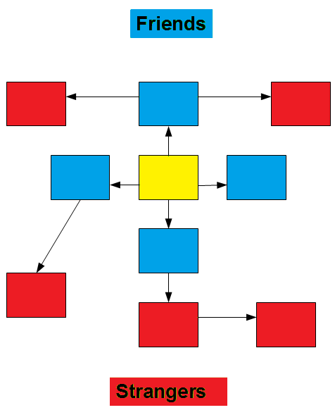
Law of Demeter (LoD)
Only talk to units “closely” related to the current unit

Slide 31
Prototype

Slide 32
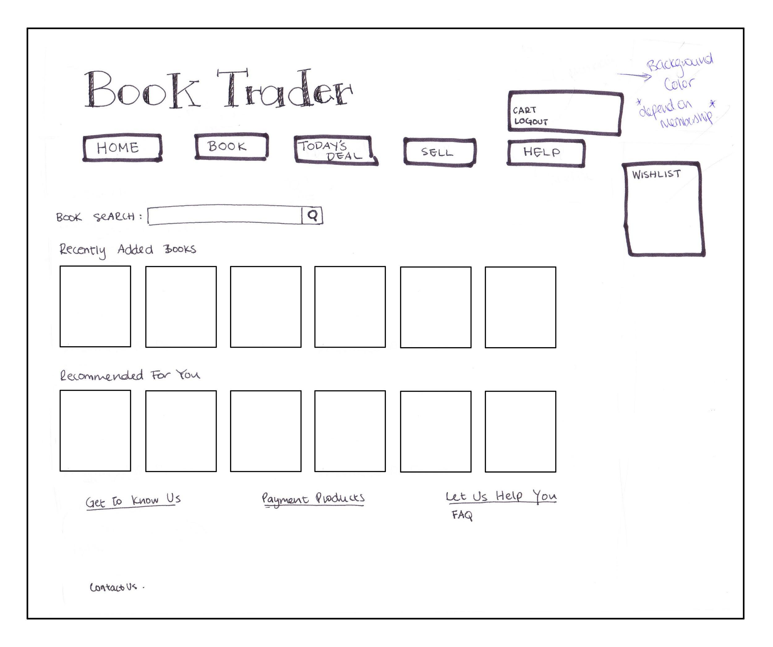
Home Page

Slide 33
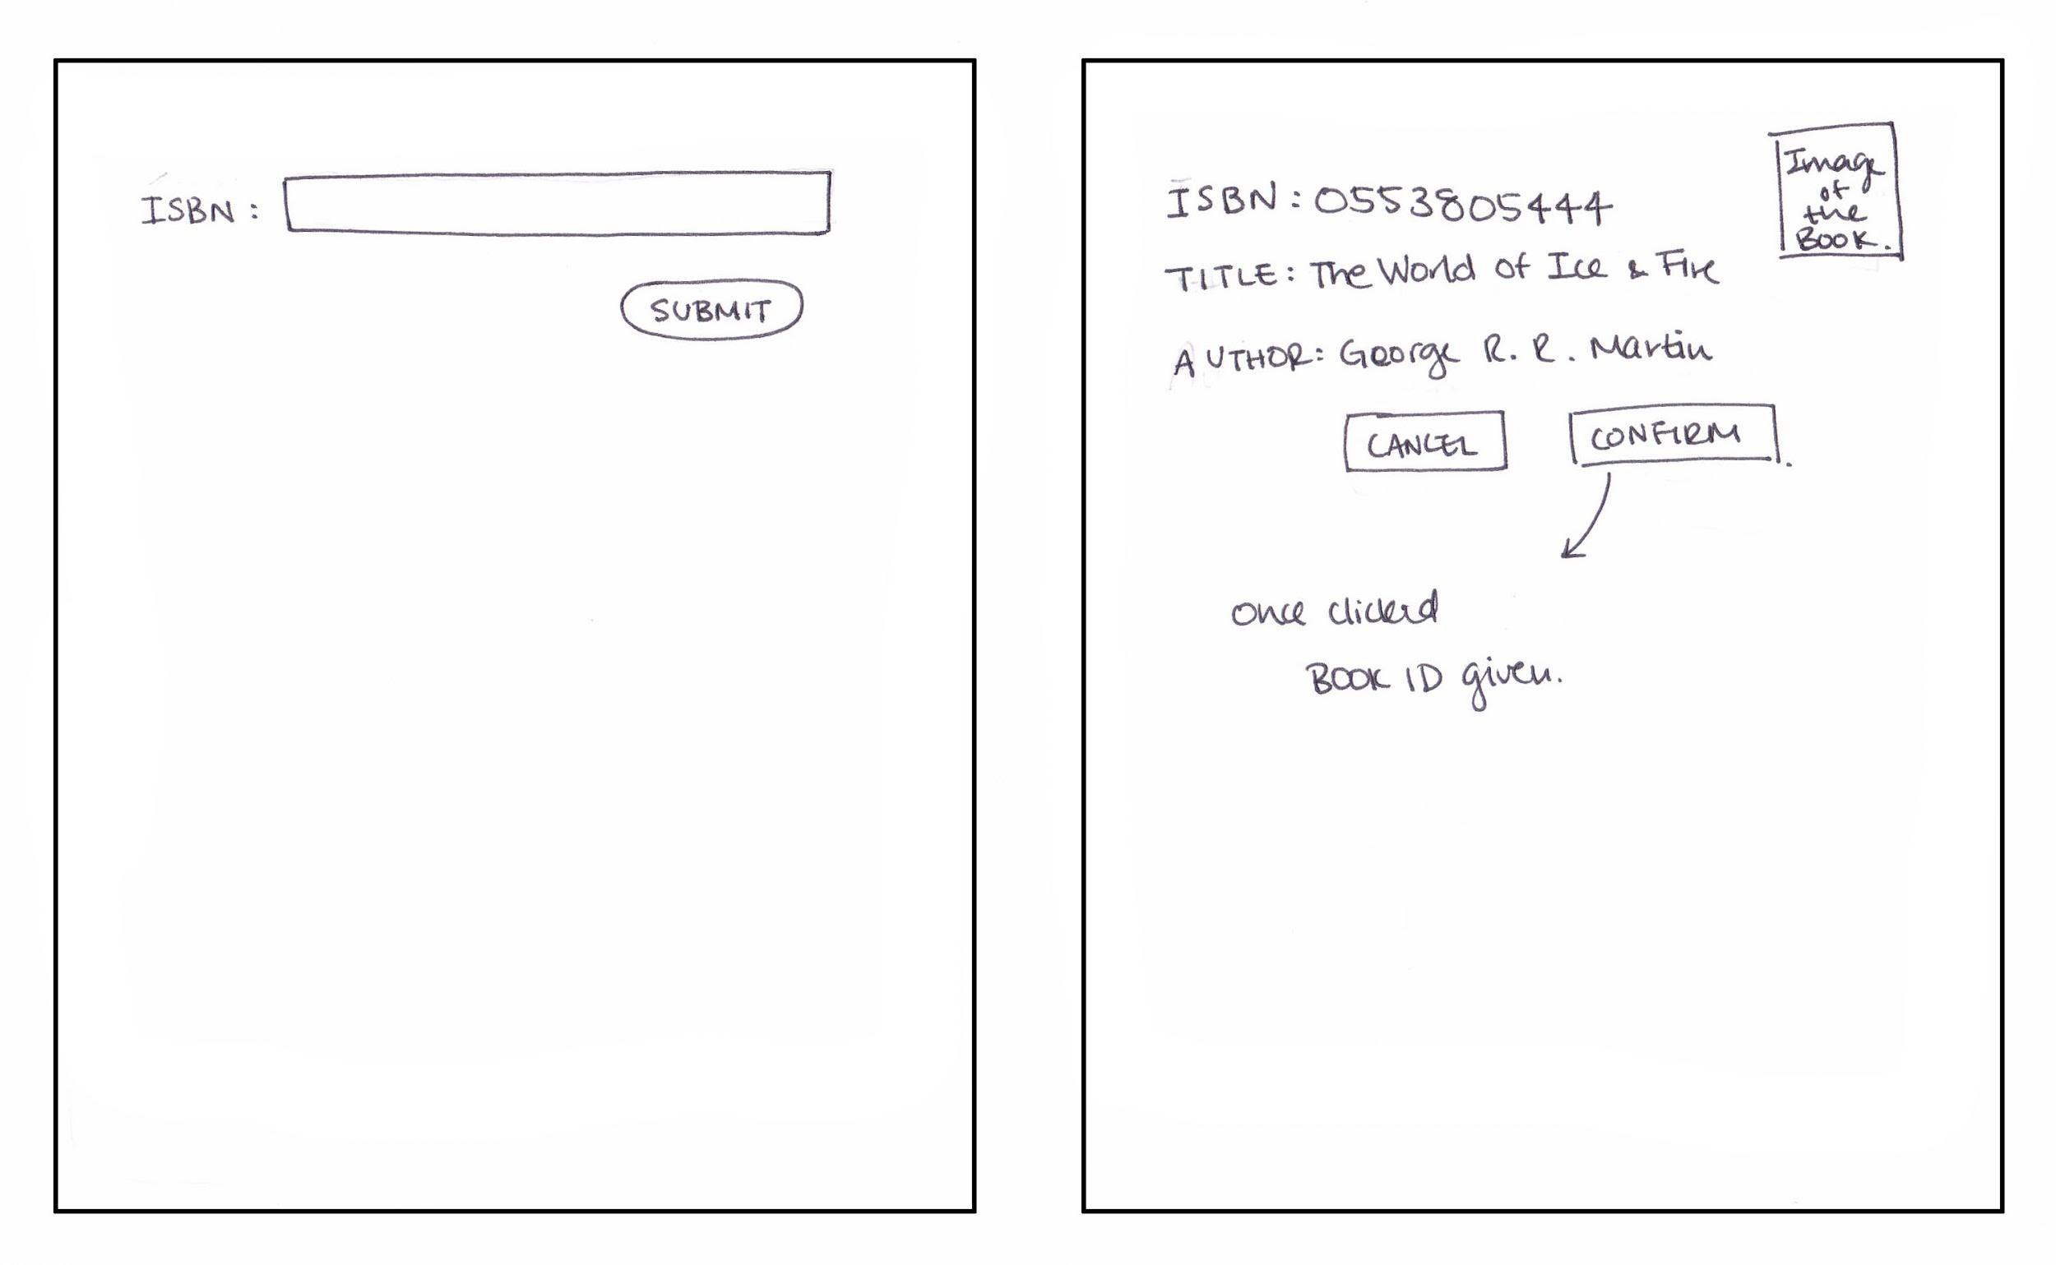
Book Sell Page

Slide 34
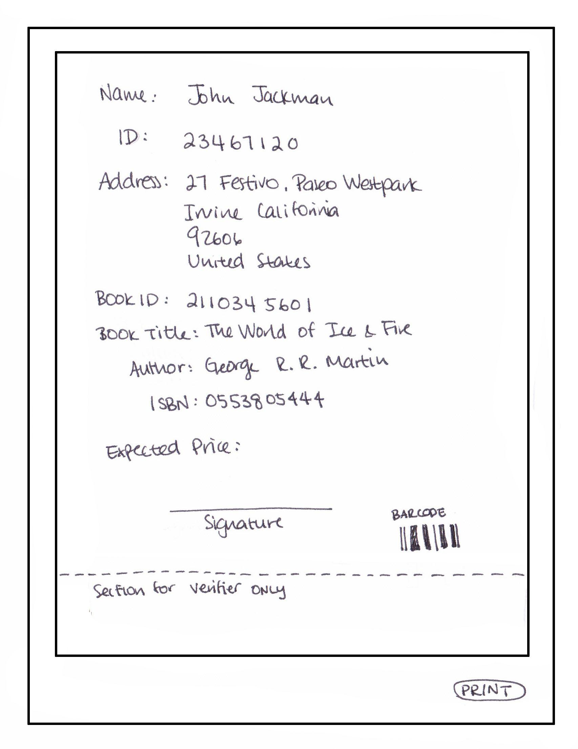

Slide 35
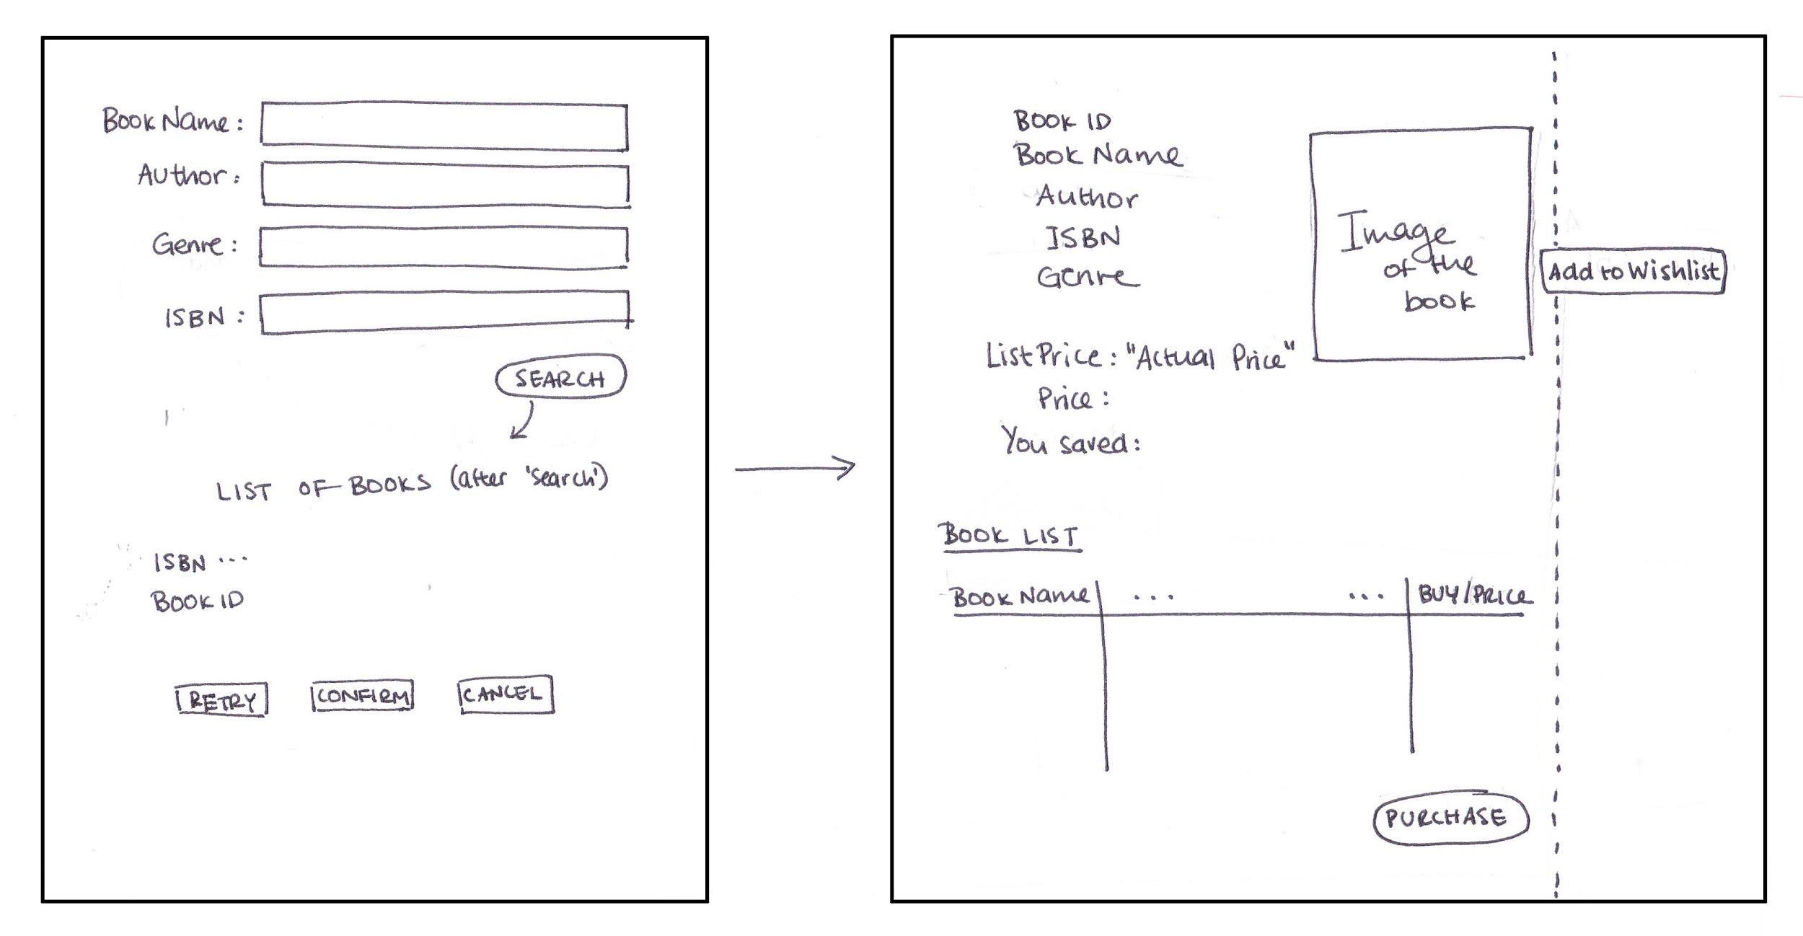
Book Search Page

Slide 36
Conclusion

Slide 37
Team Work

Slide 38
Challenges
Change of topic/details
Wrong places of operations in class diagram

Slide 39
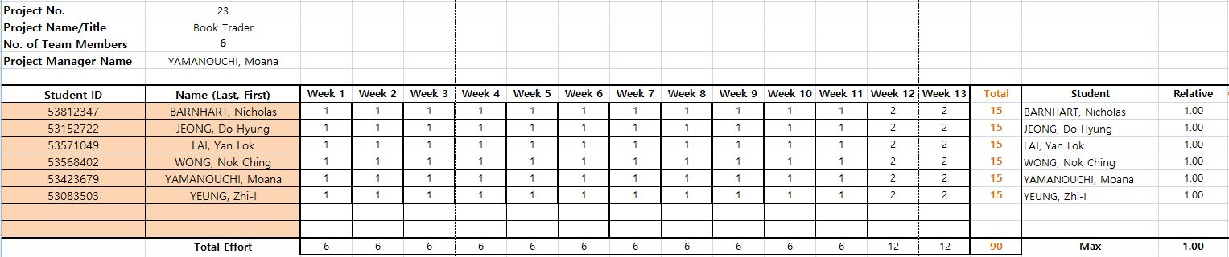
Member Contributions

